Slide 1
Bank Client Data Analysis and Visualization.
Visualizations and Key Insights.

Slide 2
Introduction
Objective: Perform EDA and visualize the bank client dataset.
Dataset Overview:
Total Records: 5211.
Key Attributes: Age, Job, Marital Status, Education, Balance, Loan Status, Contact Details.

Slide 3
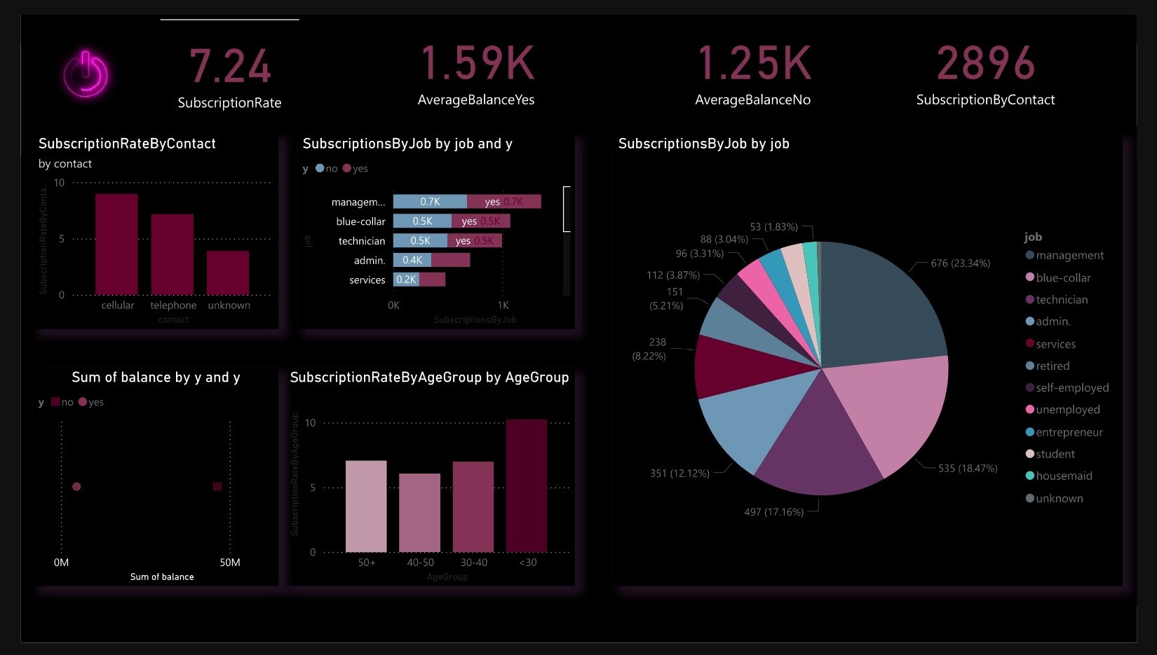
Dashboard: Subscription Analysis

Slide 4
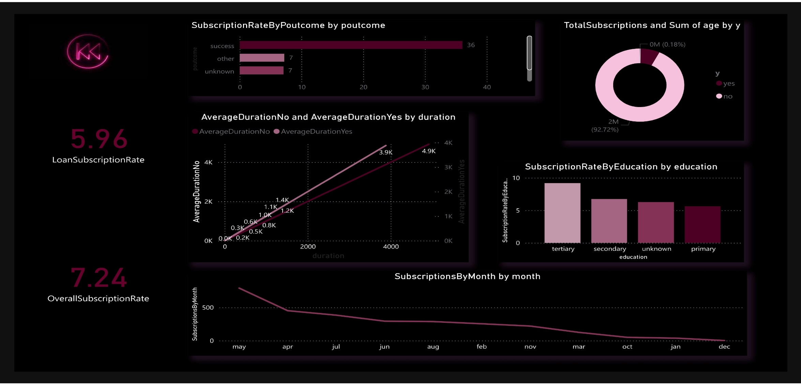
Dashboard: Subscription Analysis

Slide 5
Conclusion and Recommendations
Findings:
Housing loans are common among married individuals.
Retired clients have higher average balances.
Cellular contact method leads to better outcomes.
Recommendations:
Focus campaigns on high-balance age groups and job categories.
Leverage cellular contact methods.
Optimize call durations for success.

Slide 6


Thank You!
Feel free to ask questions
Prepared by: [Aditya, Prabhat Kumar Ganguli,Nikhil kumar].

